Slide 1

Chapter 13
Wired LANs: Ethernet

Slide 2
13-1 IEEE STANDARDS
In 1985, the Computer Society of the IEEE started a project, called Project 802, to set standards to enable intercommunication among equipment from a variety of manufacturers. Project 802 is a way of specifying functions of the physical layer and the data link layer of major LAN protocols.
Topics discussed in this section:
Data Link Layer
Physical Layer

Slide 3

IEEE Standards
The data link layer has subdivided into two sublayers;
  Logical link control (LLC) and media access control (MAC)
Figure 13.1 IEEE standard for LANs

Slide 4

IEEE Standards
Logical Link Control (LLC)
  Flow control, error control, and part of the framing duties are collected into the LLC.
Media Access Control (MAC)
  MAC defines the specific access method for each LAN.
  MAC contains a No. of distinct modules.
Figure 13.2 HDLC frame compared with LLC and MAC frames

Slide 5
13-2 STANDARD ETHERNET
The original Ethernet was created in 1976 at Xerox’s Palo Alto Research Center (PARC). Since then, it has gone through four generations. We briefly discuss the Standard (or traditional) Ethernet in this section.
Topics discussed in this section:
MAC Sublayer
Physical Layer

Slide 6

Standard Ethernet
Figure 13.3 Ethernet evolution through four generations

Slide 7
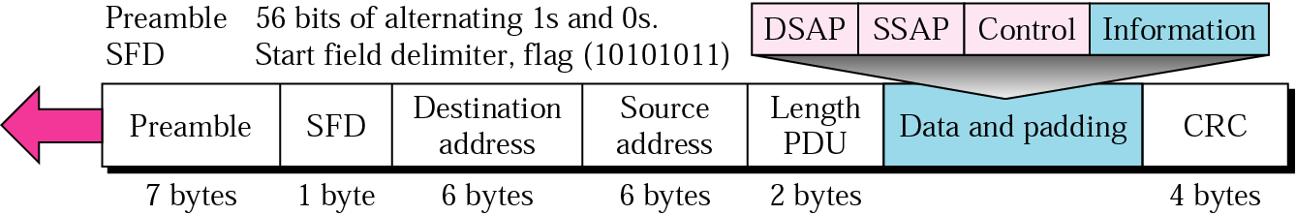
MAC Sublayer
Figure 13.4 802.3 MAC frame
Preamble – 7 bytes of alternating 0s and 1s to alert the receiver and allow it to synchronize
Start Frame Delimiter (SFD) – 1 byte – 10101011 signals the beginning of a frame, last chance for synchronization – last 2 bits are 11
Destination address (DA) – 6 bytes – contains the physical address of the destination station or stations
Source address (SA) – 6 bytes – contains the physical address of the sender
Length/type – it defines the length of the data field or to define upper-layer protocol using MAC frame
Data – data encapsulated from upper-layer protocols : 46 ~ 1500 bytes
CRC – CRC-32

Slide 8
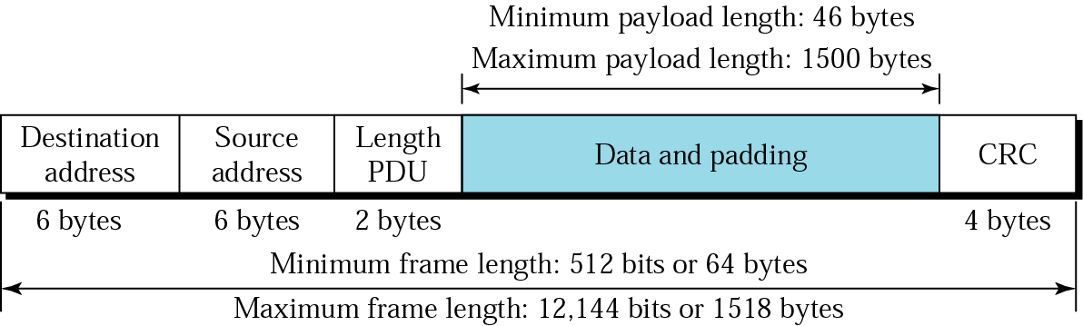
Figure 13.5 Minimum and maximum lengths
MAC Sublayer
Frame length:
Minimum: 64 bytes (512 bits)
Maximum: 1518 bytes (12,144 bits)

Slide 9

Figure 13.6 Example of an Ethernet address in hexadecimal notation
MAC Addressing
Ethernet addresses in hexadecimal notation
Each station on an Ethernet network has its own network interface card (NIC)
NIC provides the station with a 6-byte physical address

Slide 10

MAC Addressing
The least significant bit of the first byte defines
the type of address.
  If the bit is 0, the address is unicast;
  otherwise, it is multicast.
The broadcast destination address is a special
case of the multicast address in which all bits
are 1s.
Figure 13.7 Unicast and multicast addresses

Slide 11
Access Method : CSMA/CD
Standard Ethernet uses 1-presistent CSMA/CD
Slot time
  Slot time = round-trip time + time required to send the jam sequence (10Mbps Ethernet : 51.2µs)
Slot time & Maximum Network Length
  Max Length = Propagation speed x (slot time / 2)
  = (2x10⁸ ) x (51.2 x 10⁻⁶ /2) = 5,120m
  Maximum Length of a traditional Ethernetwork is reduced to 2,500m, because of the delay time in repeater and interfaces, and the time required to send the jam sequence.

Slide 12

Physical layer
Figure 13.8 Categories of Standard Ethernet

Slide 13

Encoding and Decoding
Figure 13.9 Encoding in a Standard Ethernet implementation

Slide 14

10 Base-5 : Thick Ethernet
Thick Ethernet or Thicknet
Bus topology, external transceiver
Connection of a station to the medium using 10Base5
Figure 13.10 10Base5 implementation

Slide 15

10 Base-2 : Thin Ethernet
Connection if stations to the medium using 10Base2
Thin Ethernet or Cheapernet
Bus topology, internal transceiver or a point-to-point connection via an external transceiver
Figure 13.11 10Base2 implementation

Slide 16

10 Base-T : Twisted Pair Ethernet
Physical star topology
Stations connected to a hub with internal or external transceiver
Figure 13.12 10Base-T implementation

Slide 17

10 Base-F : Fiber Ethernet
Fiber link Ethernet
Uses star topology to connect stations to a hub
Normally implemented with external transceiver having two pairs of fiber-optic cables connecting it to the hub.
Figure 13.13 10Base-F implementation

Slide 18
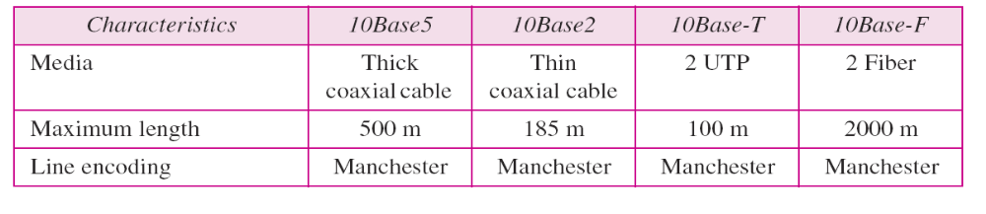
Summary of Ethernet
Table 13.1 Summary of Standard Ethernet implementations

Slide 19
13-3 CHANGES IN THE STANDARD
The 10-Mbps Standard Ethernet has gone through several changes before moving to the higher data rates. These changes actually opened the road to the evolution of the Ethernet to become compatible with other high-data-rate LANs.
Topics discussed in this section:
Bridged Ethernet
Switched Ethernet
Full-Duplex Ethernet

Slide 20
Bridged Ethernet
Raising the bandwidth
Separating collision domains

Slide 21


Raising the Bandwidth
Figure 13.14 Sharing bandwidth
A Network with and without a Bridge
  10/6 Mbps vs 10/12 Mbps in case that traffic is not going through the bridge

Slide 22

Separating Collision Domains
Figure 13.16 Collision domains in an unbridged network and a bridged network

Slide 23

Switched Ethernet
Bandwidth is shared only between the station and the switch (5 Mbps each)
N-port switch; Switched Ethernet

Slide 24

Full-Duplex Ethernet
A Limitation of 10Base5 and 10Base2 - half-duplex.
Evolution : switched Ethernet → full duplex Switched Ethernet
  10Base-T is always Full-duplex.
Full duplex mode increases the capacity of each domain from
10 to 20 Mpbs.

Slide 25
Full-Duplex Ethernet
Traditional Ethernet was designed as a connectionless protocol at the MAC sublayer .
  No explicit flow control or error control to inform the sender that the frame has arrived at the destination without error.
For flow and error control in full-duplex switched Ethernet
  No need for CSMA/CD, this functionality can be turned off.
    Each link is a point-to-point dedicated path between the station and the switch.
  Adding a sublayer called MAC Control between MAC sublayer and LLC sublayer

Slide 26
13-4 FAST ETHERNET
Fast Ethernet was designed to compete with LAN protocols such as FDDI or Fiber Channel. IEEE created Fast Ethernet under the name 802.3u. Fast Ethernet is backward-compatible with Standard Ethernet, but it can transmit data 10 times faster at a rate of 100 Mbps.
Topics discussed in this section:
MAC Sublayer
Physical Layer

Slide 27
The goals of the Fast Ethernet
Upgrade the data rate to 100Mbps.
Make it compatible with Standard Ethernet.
Keep the same 48 bit address.
Use the same frame format.
Keep the same minimum and maximum frame lengths.

Slide 28
MAC Sublayer - Fast Ethernet
Evolution from 10 to 100 Mpbs doesn’t change the
MAC sublayer.
Access method is CSMA/CD
  for the half-duplex approach, which is kept for backward compatibility;
  for full duplex Fast Ethernet, there is no need for CSMA/CD
Frame format, minimum and maximum frame lengths,
and addressing are the same.

Slide 29
Autonegotiation
Allowing two devices to negotiate the mode or data rate of operation.
  To allow incompatible devices to connect to one another. For example, between 10 Mbps-device and 100 Mbps-device
  To allow one device to have multiple capabilities
  To allow a station to check a hub’s capabilities

Slide 30

Physical layer – Fast Ethernet
Figure 13.19 Fast Ethernet topology

Slide 31

Physical layer – Fast Ethernet
Figure 13.20 Fast Ethernet implementations

Slide 32


Physical layer – Fast Ethernet
Encoding/decoding – first performs block encoding using 4B/5B, then encoded using MLT-3 (multiline transmission, three level)
Figure 13.21 Encoding for Fast Ethernet implementation

Slide 33
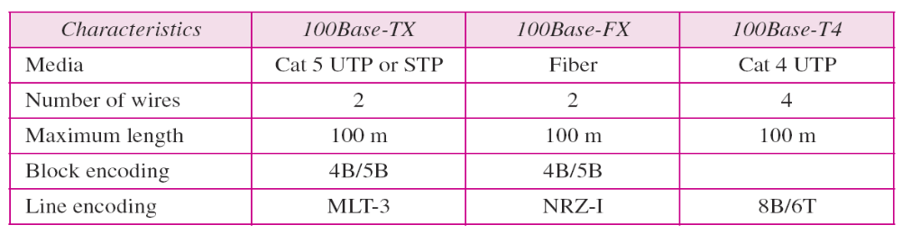
Physical layer – Fast Ethernet
Table 13.2 Summary of Fast Ethernet implementations

Slide 34
13-5 GIGABIT ETHERNET
The need for an even higher data rate resulted in the design of the Gigabit Ethernet protocol (1000 Mbps). The IEEE committee calls the standard 802.3z.
Topics discussed in this section:
MAC Sublayer
Physical Layer
Ten-Gigabit Ethernet

Slide 35
The goals of the Gigabit Ethernet
Upgrade the data rate to 1Gbps.
Make it compatible with Standard or fast Ethernet.
Use the same 48 bit address.
Keep the same frame format.
Keep the same minimum and maximum frame lengths.
To support autonegotiation as defined in Fast Ethernet.

Slide 36
MAC Sulayer - Gigabit Ethernet
Gigabit Ethernet has two approaches for Multiple Access
: half-duplex and full-duplex
  Almost all implementations of Gigabit Ethernet follow the full-duplex approach.
  Half-duplex approach to show that Gigabit Ethernet can be compatible with the previous generations (Standard & Fast Ethernet).
In the full-duplex mode of Gigabit Ethernet, there is no collision;
The maximum length of the cable is determined by the signal attenuation in the cable.

Slide 37

Physical Layer - Gigabit Ethernet
Figure 13.22 Topologies of Gigabit Ethernet

Slide 38

Physical Layer - Gigabit Ethernet
Figure 13.23 Gigabit Ethernet implementations

Slide 39

Physical Layer - Gigabit Ethernet
Figure 13.24 Encoding in Gigabit Ethernet implementations

Slide 40
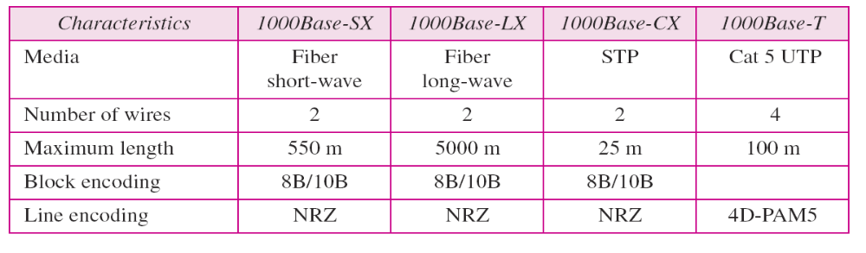
Physical Layer - Gigabit Ethernet
Table 13.3 Summary of Gigabit Ethernet implementations

Slide 41
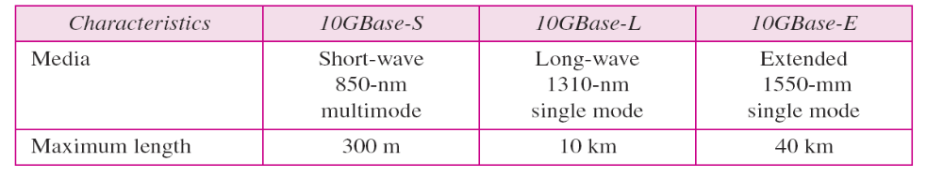
Physical Layer - Gigabit Ethernet
MAC Sublayer
  Ten-Gigabit Ethernet operates only in full duplex mode which means there is no need for contention; CSMA/CD is not used in 10-Gigabit Ethernet.
Physical Layer
  Physical layer is designed for using fiber-optic cable over long distances.
Table 13.4 Summary of Ten-Gigabit Ethernet implementations

Slide 42
Summary
Ethernet is the most widely used local area network protocols.
The IEEE 802.3 Standard defines 1-persistent CSMA/CD as the access method for first-generation 10-Mbps Ethernet.
The data link layer of Ethernet consists of the LLC sublayer and the MAC sublayer.
The MAC sublayer is responsible for the operation of the CSMA/CD access method and framing.
Each station on an Ethernet network has a unique 48-bit address imprinted on its network interface card (NIC).
The minimum frame length for 10-Mbps Ethernet is 64 bytes; the maximum is 1518 bytes.
The common implementations of 10-Mbps Ethernet are 10Base5 (thick Ethernet), 10Base2 (thin Ethernet), 10Base-T (twisted-pair Ethernet), and 10Base-F (fiber Ethernet).

Slide 43
Summary (2)
The 10Base5 implementation of Ethernet used thick coaxial cable. 10Base2 uses thin coaxial cables. 10Base-T uses four twisted-pair cables that connect each station to a common hub. 10Base-F used fiber-optic cable.
A bridge can increase the bandwidth and separate the collision domains on an Ethernet LAN.
A switch allows each station on an Ethernet LAN to have the entire capacity of the network to itself.
Full-duplex mode doubles the capacity of each domain and removes the need for CSMA/CD method.
Fast Ethernet has a data rate of 100 Mbps.

Slide 44
Summary (3)
In Fast Ethernet, autonegotiation allows two devices to negotiate the mode or data rate of operation.
The common Fast Ethernet implementations are 100Base-TX (two pairs of twisted pair cable), 100Base-FX (two fiber-optic cables), and 100Base-T4 (four pairs of voice-grade, or higher, twisted-pair cable).
Gigabit Ethernet has a data rate of 1000Mbps.
Gigabit Ethernet access methods include half-duplex mode using traditional CSMA/CD (not common) and full-duplex mode (most popular method).

Slide 45
Summary (4)
The common Gigabit Ethernet implementations are 1000Base-SX (two optical fibers and a short-wave laser source), 1000Base-LX (two optical fibers and a long-wave laser source), and 1000Base-T (four twisted pairs).
The latest Ethernet standard is Ten-Gigabit Ethernet that operates at 10 Gbps. The three common implementations are 10GBase-S, 10GBase-L, and 10GBase-E. These implementations use fiber-optic cables in full-duplex mode.

